Slide 1
Reflections
“Not Missiles, but Microbes.”
--Bill Gates Ted Talk, 2015
Project Management, Critical Event Management and COVID-19
10/28/2020

Slide 2
INTRODUCTIONS
About Jigs, Claudia & Sorin
Notes:
Thank u kyle for that. Just

Slide 3
First
My Intent
See this MPUG article for more on my intent:
https://www.mpug.com/pm-cem-and-covid-19-reflections/

Slide 4
My Methods
MPUG Survey
Hijacked Survey
Outreach
Wife
Low-voter turnout
Curiosity and Agility
PM Nomads the world over
My Window into the Enterprise

Slide 5
1 in 5
KEY FINDINGS
60%
2X
Are optimistic about 2020/2021
Expect an economic depression over the next 5 years
Agile PMs are twice as likely to report “business is good” than other PMs

Slide 6
80%
Who is adopting best to change?
56%
17%
Of PMs in tech, advertising, airlines, & aeronautics are quickly changing
Of PMs in non-profits are adopting strategies for Covid
Of PMs in manufacturing are updating products and services
13%
Of PMs in government are updating products and services

Slide 7
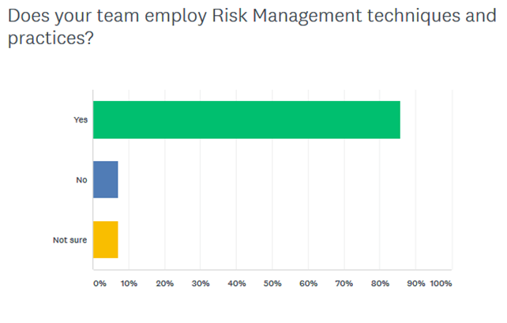

Slide 8
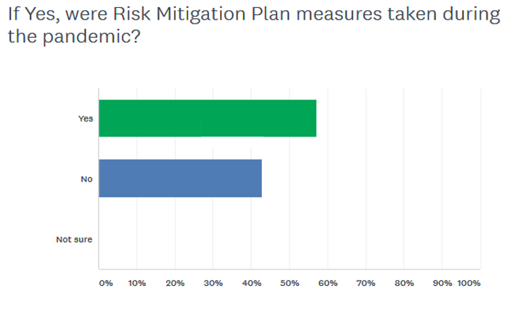

Slide 9
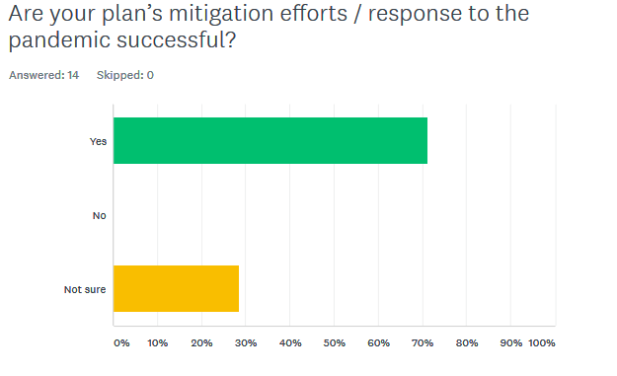

Slide 10
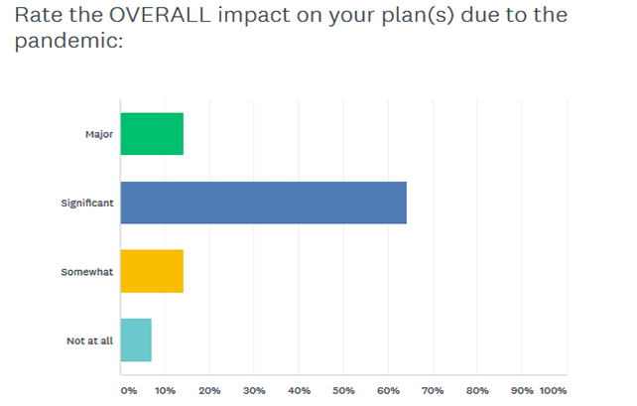

Slide 11
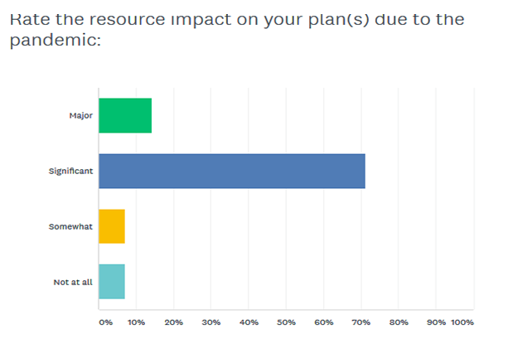

Slide 12
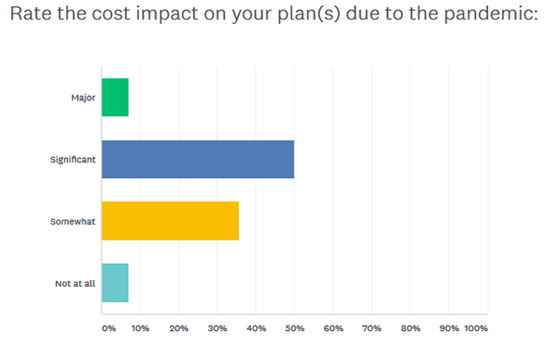

Slide 13
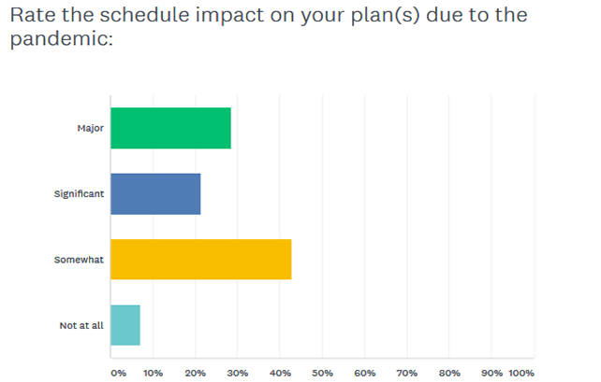

Slide 14
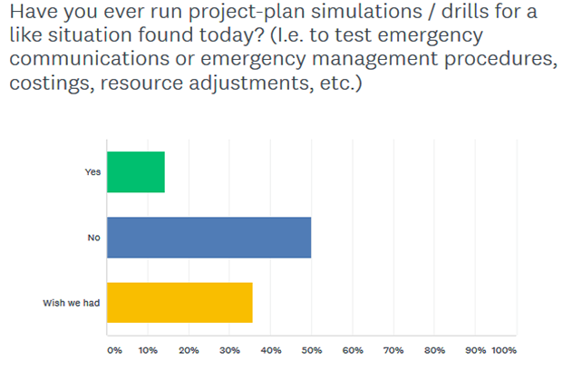

Slide 15
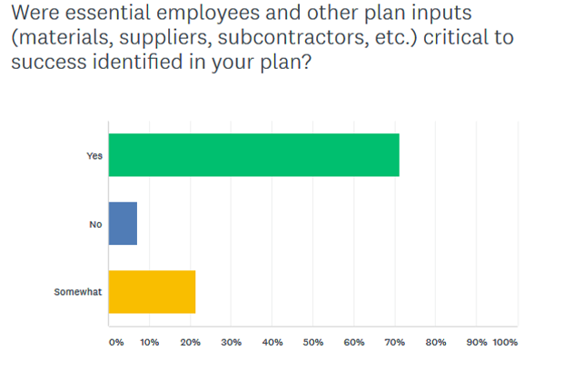

Slide 16
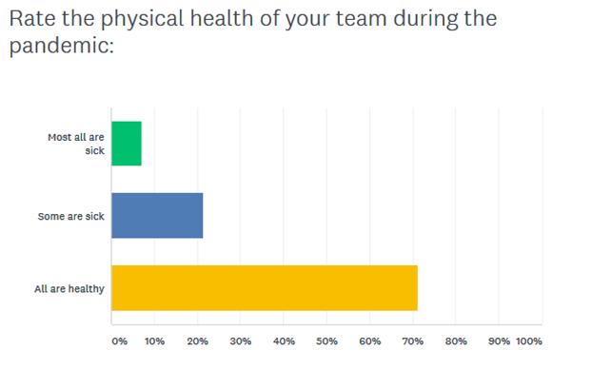

Slide 17
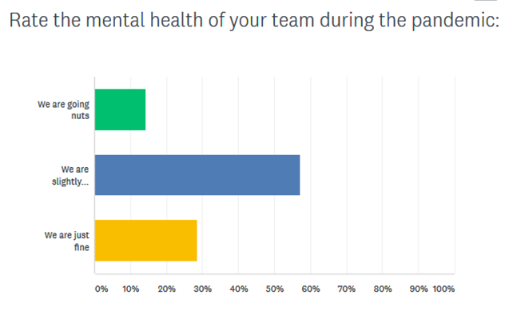

Slide 18
Counter Measures Taken
Virtual video meetings (for everything)
Physical separation in the office
Limited work hours / rolling shifts
PPE distribution enterprise-wide
Work-from-Home plans initiated
Local surrogates replacing International travel

Slide 19
Lessons Learned So Far
Out of box thinking / better teamwork needed
Be proactive and always on Swan Alert
Work backward from complete failure
If you are not affected, just keep on truck 'in
Go slow, and be patient

Slide 20
Helpful Software Tools
MS Teams and Confluence
MS Project and Project Plan 365
Zoom and WebEx
Google Meet
COVID-19 Heat Maps

Slide 21
My final question
Can AI save the day (and days ahead)?

